Slide 1
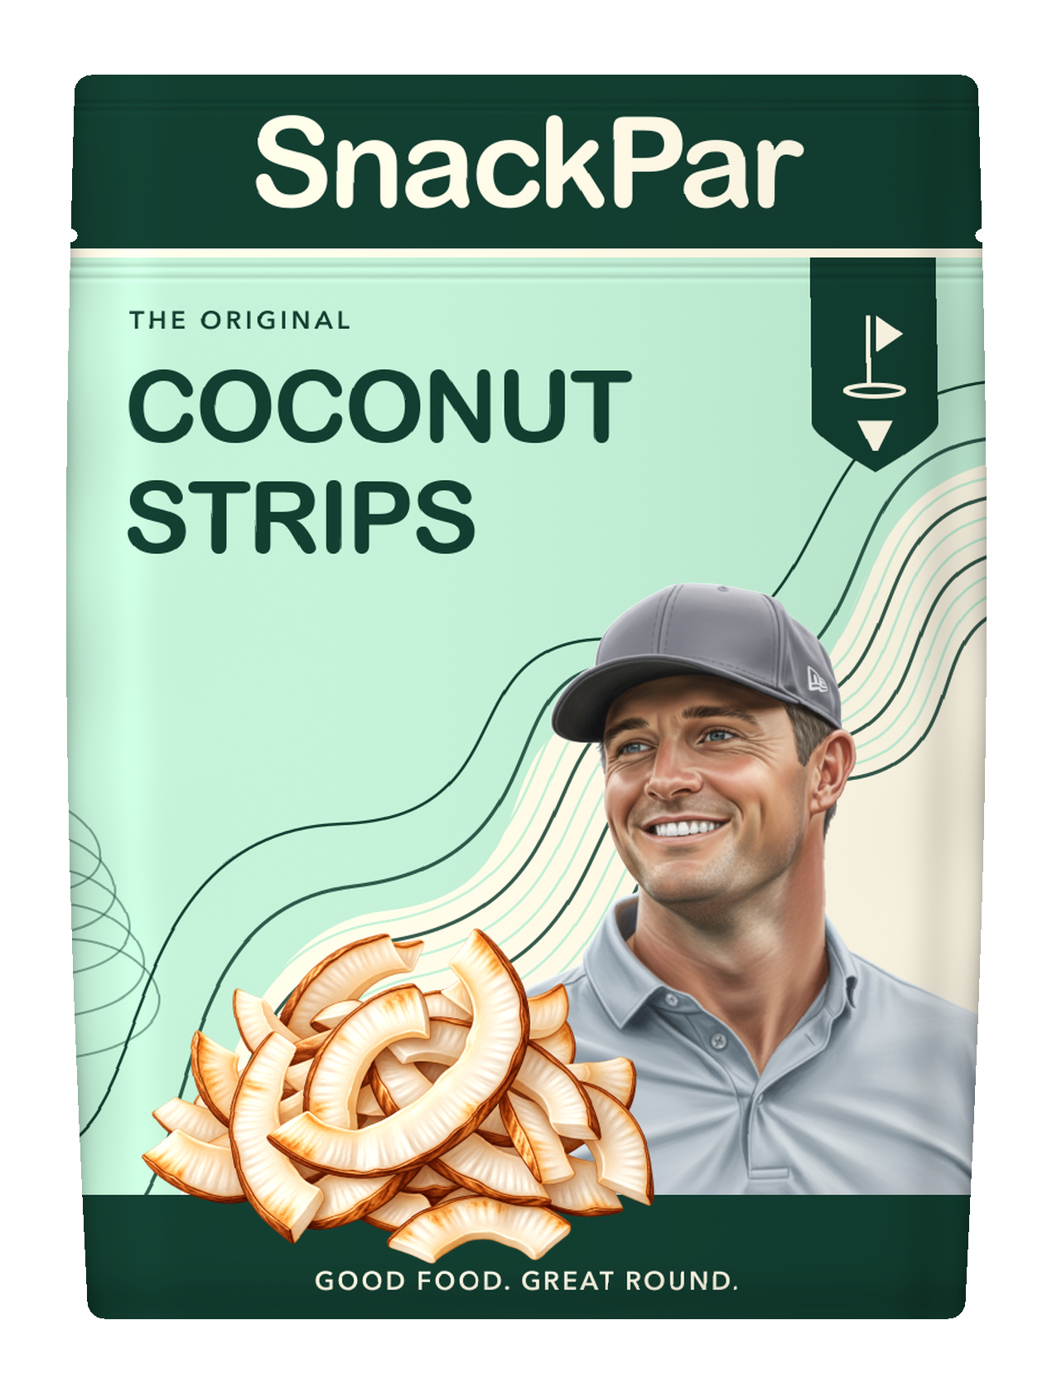
SnackPar
A little fun.
For the
long game.
A golf-born snack brand
Proposed partnership with Bryson DeChambeau
Partnership + investment discussion / October 2026
Notes:
Independent proposal, prepared for discussion. No endorsement, commercial agreement or charity relationship is confirmed. The coconut-strips concept is the proposed launch hero. Product illustrations and packaging are concepts, not manufacturing specifications. The investment discussion is about validation and readiness, not an announced fundraise.

Slide 2

SnackPar
02
The snack break
is part of the round
An enjoyable snack that belongs in a golf bag and feels like part of the game.
Coconut strips give SnackPar a focused first taste. Product quality and repeat demand decide what comes next.
Working proposition to test with consumers. The final origin story would be developed with Bryson’s team.
Notes:
Strategic recommendation: a focused first coconut product, with the wider range treated as a development roadmap. This is a consumer proposition, not a claim of validated unmet demand. The user identifies coconut strips as the creative anchor. Original snack-video scene and rights remain unverified, so no quote, exact appearance, guest reaction or recipe attribution appears.

Slide 3
SnackPar
03
Golf is the starting point
48M+
+41%
Participation growth
since 2019
U.S. on- and off-course participants in 2025
A focused launch audience for product testing.
A starting point for expansion beyond golf.
Source: National Golf Foundation, March 6, 2026. Participation is not a snack-market estimate or a demand forecast.
Notes:
Primary source verified October 3, 2026 by the project research review: https://www.ngf.org/short-game/golfs-growth-era-the-road-to-50-million-golfers/ . NGF reports more than 48 million Americans hit golf balls on or off course in 2025, with 41% growth from 2019 to 2025. Its 50 million figure is a forecast, not an achieved count. Participants are not SnackPar customers, snack buyers or a revenue TAM. Do not apply an unsupported conversion rate.

Slide 4
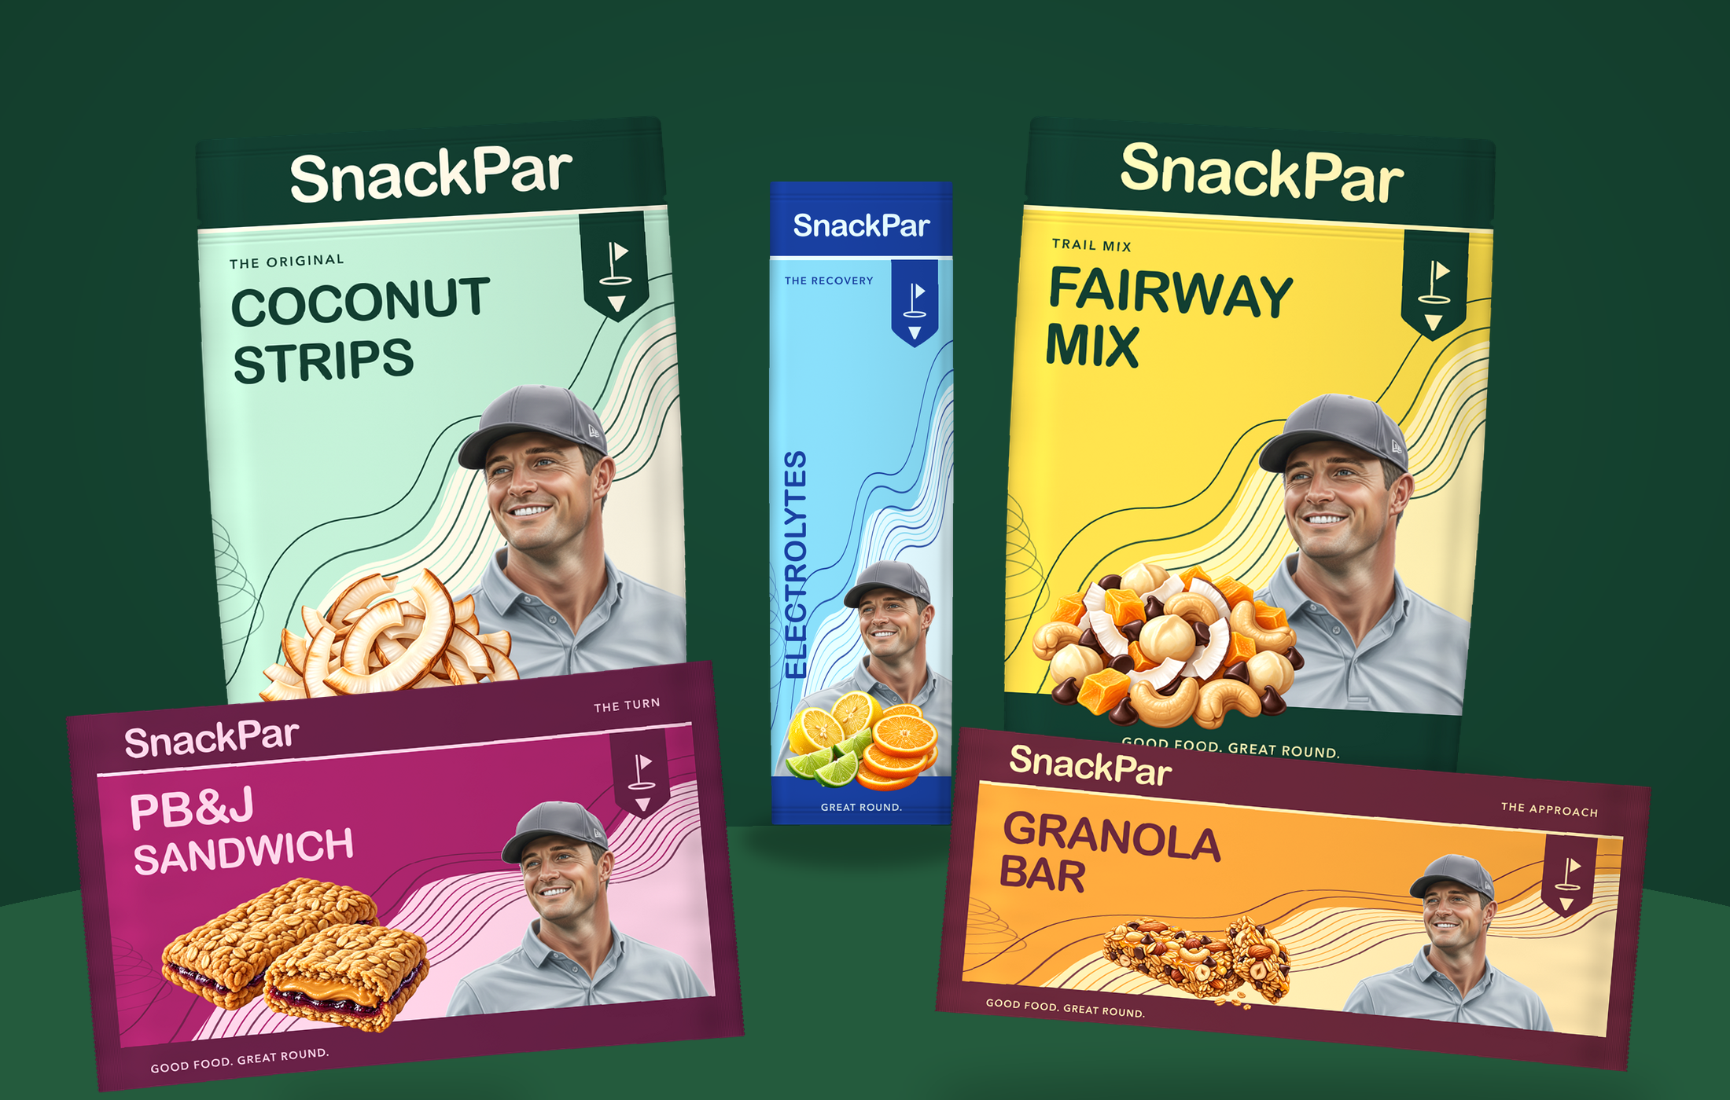
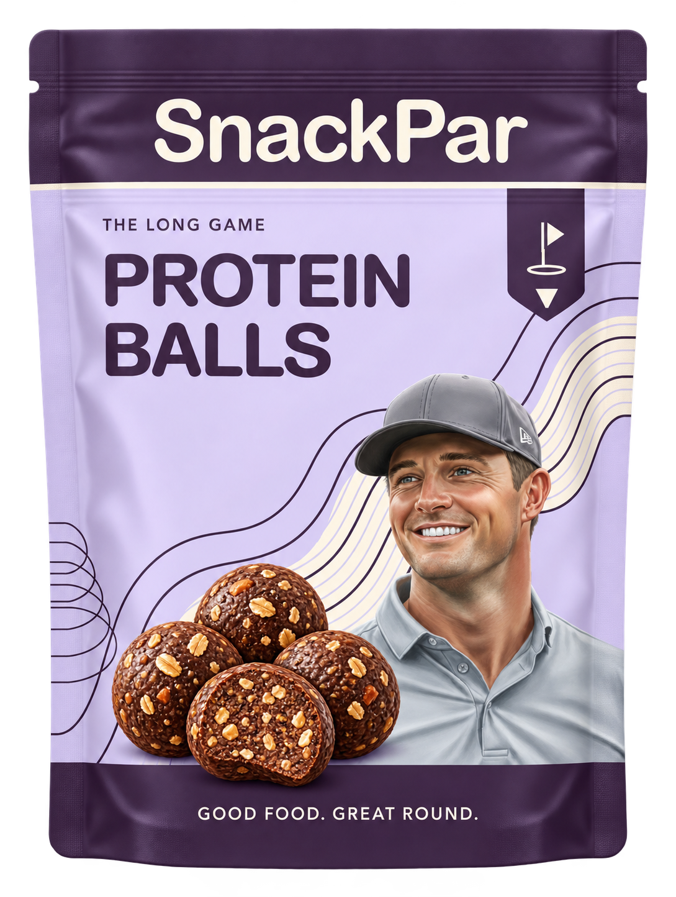
SnackPar
04
One launch hero. Room to build the bag
Launch candidate
Coconut
strips
Other formats follow product and economic validation.
Protein Balls
Product concepts. Timing follows taste, costs, shelf life and fulfillment readiness.
Notes:
The working range is coconut strips, PB&J sandwich, granola bar, electrolytes, Fairway Mix and Protein Balls. The proposal recommends launching only after one hero product passes product and commercial validation. Other products are potential extensions, not committed launch inventory. PB&J needs an explicit storage, shelf-life and shipping decision before inclusion. Formulation, allergens, pack size, nutrition and specifications remain open. The separate lineup render repeats product designs intentionally to show one coherent portfolio.

Slide 5
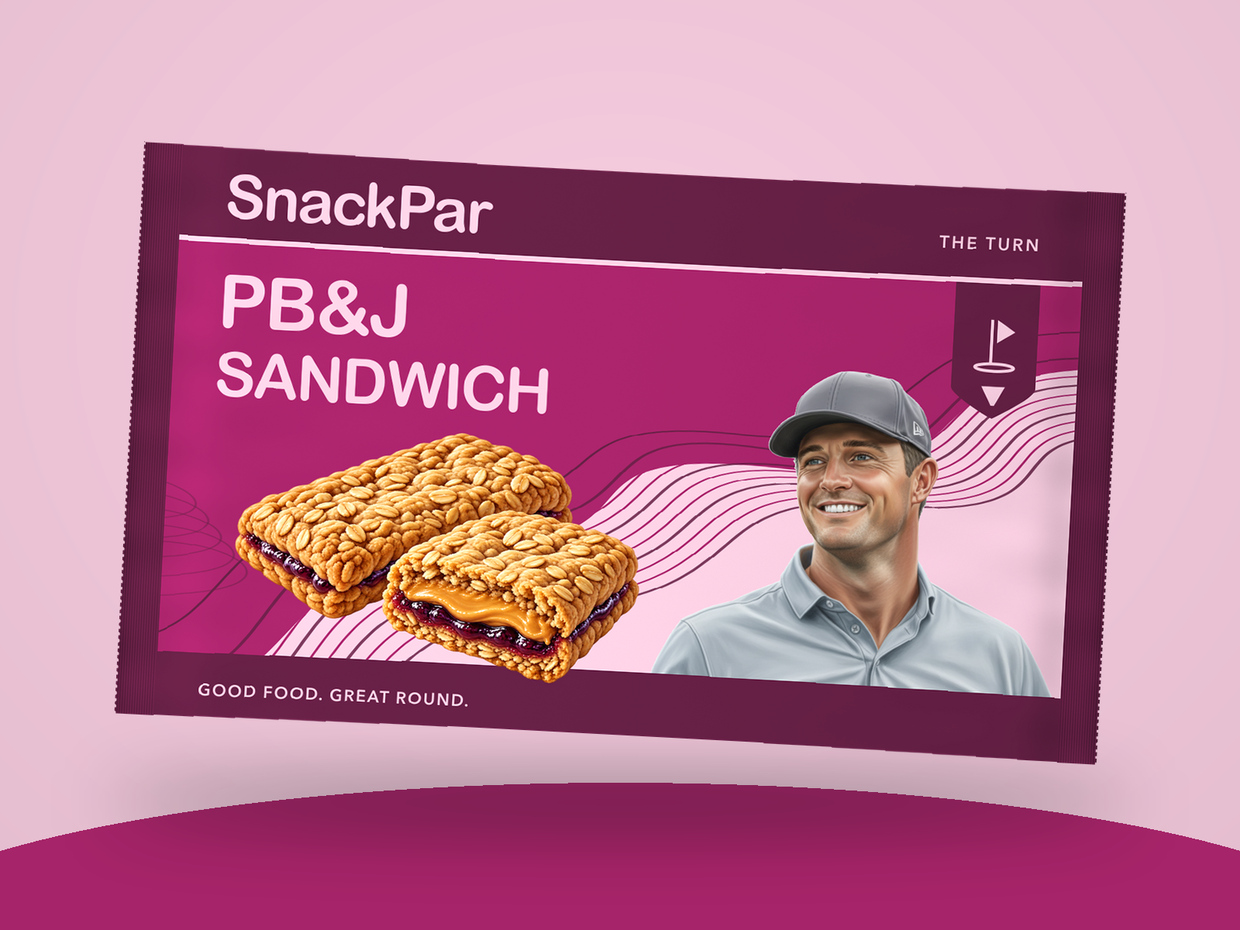
SnackPar
05
Food first.
Golf in the
attitude
Bold product colors. Familiar snacks.
A playful world people can join.
The ambition is everyday appeal, with golf as the point of introduction.
Visual identity and product artwork are concepts. Consumer preference still needs testing.
Notes:
The v3 packaging returns to the supplied North Star structure with a prominent supplied portrait, contour pattern, dark header and base. Distinct product colors, illustrated food and the rounded wordmark retain the approved v2 refinements. This slide presents consumer positioning rather than a proven purchase driver. PB&J is a potential extension whose feasibility remains unconfirmed. SnackPar’s ambition beyond golf is a strategy hypothesis, not existing household penetration or retail reach.

Slide 6
SnackPar
06
Bryson as a potential brand partner
A tangible way for fans to take part
Product involvement
Taste, format and brand fit.
The right partnership would connect a product he wants to share with a brand people want to buy again.
Creative leadership
A paid scope led by his team.
Commercial participation
Rights and economics that reflect each side’s contribution.
Proposed relationship. Category availability, likeness rights, scope and commercial terms require agreement.
Notes:
No endorsement or partnership exists. Possible endorsement, royalty or ownership structures remain discussion topics. Product input, approval rights, territory, term, category exclusivity and economics require negotiation. Bryson’s existing creative team is the proposed lead for content, with paid scoped capacity. No free work, content cadence, audience access or conversion promise is assumed.

Slide 7
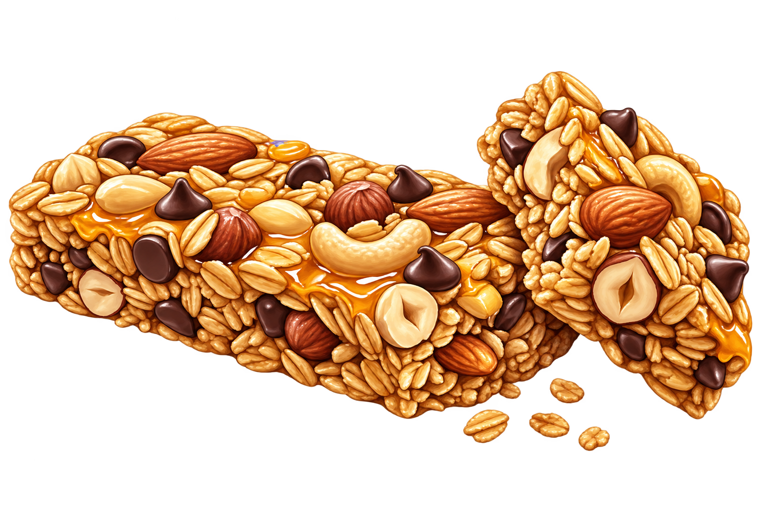
SnackPar
07
Content earns the first taste
What’s in the Bag?
Introduce the coconut product and the reason behind it.
At the Turn
A natural snack break, with an honest guest reaction.
Build the Bag
Let viewers follow taste and product development.
Each proposed integration leads to a clear product page. Measure visits, purchases and repeat orders.
Notes:
Content formats are proposals, not existing commitments or fabricated footage. His team would select editorial fit, guests and schedule in a scoped paid engagement. SnackPar supports product samples and approved brand assets. Track tagged visits, conversion, product feedback, refunds and repeat orders. Do not treat views as product demand or script guest praise. All advertising disclosure and usage rights require agreed terms.

Slide 8
SnackPar
08
A measured route to the shelf
01
02
03
Direct launch
Golf venues
Wider retail
A focused online offer
A small wholesale pilot
Expansion after repeat demand
Validate purchase intent, delivery quality and contribution per order.
Test sell-through, reorder behavior and viable retailer economics.
Prove capacity, working capital and the offer’s relevance beyond golf.
Proposed sequence. No retailer, distributor or golf-course commitment exists.
Notes:
Route-to-market recommendation: a focused direct offer before a small golf-venue wholesale test, followed by wider distribution only when demand, margins and capacity support it. No channel commitment, customer acquisition cost, retailer margin, sell-through rate or sales forecast exists. Evidence gates must be agreed before any pilot.

Slide 9
SnackPar
09
The first 90 days
Illustrative plan, beginning after scope and budget approval
Days 1–30
Days 31–60
Days 61–90
Product + fit
Offer + operations
Controlled trial
Coconut samples, taste feedback and costed manufacturing options.
Pack and pricing tests, fulfillment trial and partnership scope.
A limited test with agreed measures for purchase, quality and repeat demand.
Gate: a product worth testing.
Gate: a feasible paid pilot.
Gate: expand, revise or stop.
Notes:
Illustrative proposed 90-day validation plan. This is not an approved launch date or guaranteed manufacturing schedule. Timeline starts only after scope and budget approval, and product readiness may extend it. Days 1–30: samples, taste testing, manufacturing options and partner fit. Days 31–60: pricing and pack tests, fulfillment trial, rights and production scope. Days 61–90: limited trial only if prior gates pass. Quantitative success thresholds must be set in advance using real product costs and business objectives.

Slide 10
SnackPar
10
The economics we need to prove
Decision | Inputs required | Evidence before scale
Direct sales | Price, landed COGS, royalties, giving, fulfillment, fees, returns and acquisition. | Positive contribution per order and credible repeat demand.
Wholesale | Wholesale price, COGS and freight, royalties, giving and trade terms. | Viable margin for SnackPar and the retail partner.
Capital required | Inventory deposits, lead times, production scope and operating costs. | A funded pilot budget and a working-capital plan.
A financing ask follows cost validation and pilot scope
Notes:
No actual revenue, margin, customer acquisition cost, retention, purchase order, capital ask or valuation has been supplied. These are the evidence requirements for an investment discussion. COGS means cost of goods sold. Contribution per direct order should subtract landed COGS, fulfillment, payment/platform fees, returns, agreed variable royalty and giving costs, and attributable paid acquisition from net collected revenue. Separately budget fixed partnership/production fees and overhead. Wholesale analysis includes product costs, agreed royalty and giving cost, trade/distributor economics, freight, discounts, returns and payment terms. Do not present contribution as profit or substitute a forecast for operating evidence.

Slide 11
SnackPar
11
Clear roles and a giving program
Who brings what
Play It Forward
SnackPar operator
SnackPar funds an agreed amount for each eligible pack sold.
Product, manufacturing and fulfillment.
SnackPar creative
Brand, packaging and campaign assets.
A recurring golf challenge shares the cause and contributions paid.
Bryson’s team
Approved participation and paid content scope.
Bryson’s team selects the cause. Terms cover eligibility, timing, caps and reporting.
All roles and giving terms are proposals. No beneficiary, contribution rate or partnership has been confirmed.
Notes:
The user owns manufacturing and physical product execution. Proposed roles require agreement, particularly creative-team scope, capacity, fees and usage rights. Giving proposal: SnackPar company pays eligible net packs sold multiplied by an agreed contribution per pack. It is not a customer donation or an assumed deduction from Bryson’s royalty. A beneficiary agreement defines rate, eligible products, timing, returns, cap if any, payment and reporting. No beneficiary, contribution amount or charitable relationship is confirmed. No historical charity relationship is needed to support this prospective proposal.

Slide 12
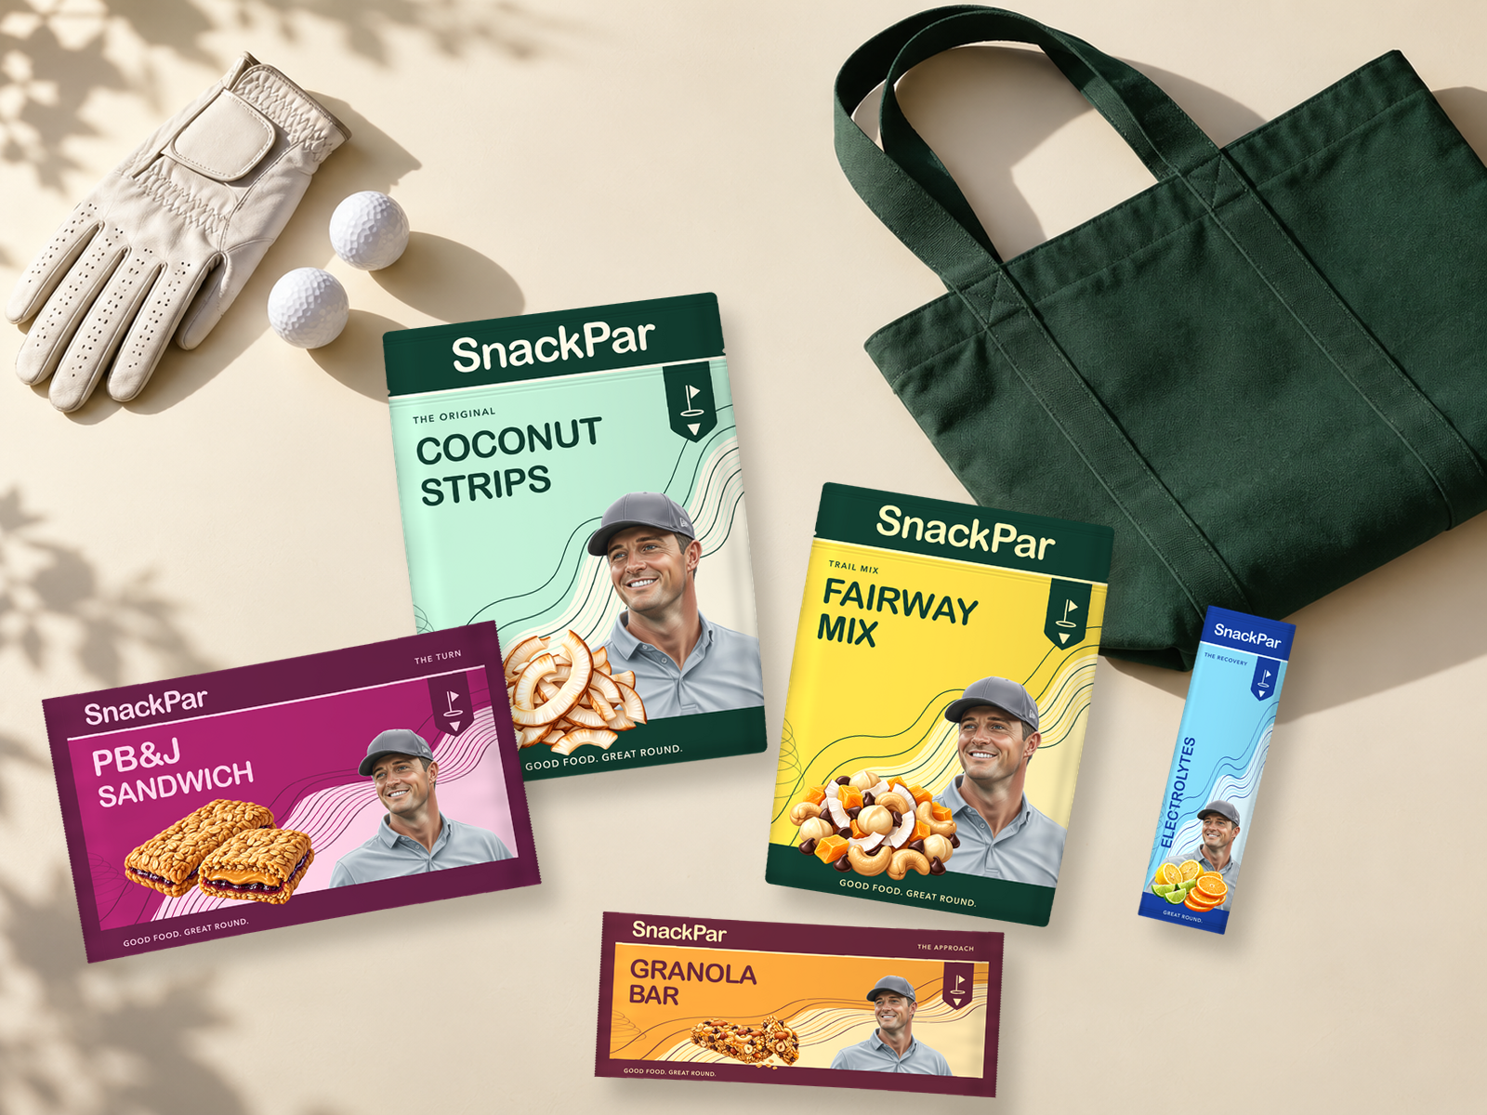
SnackPar
12
Bryson’s Bag
A giftable introduction
to the brand
A future kit could bring the range together for samples, launch storytelling and gifting.
Final contents, storage and economics follow product validation.
Notes:
Bryson’s Bag is an independent creative concept and future product-world illustration, not an approved collaboration or committed launch bundle. The image shows all five product concepts together. Contents, pack sizes, timing, product readiness, storage needs and bundle economics require validation. The launch recommendation remains coconut first. No merchandise, gifting or charity partner has committed.

Slide 13
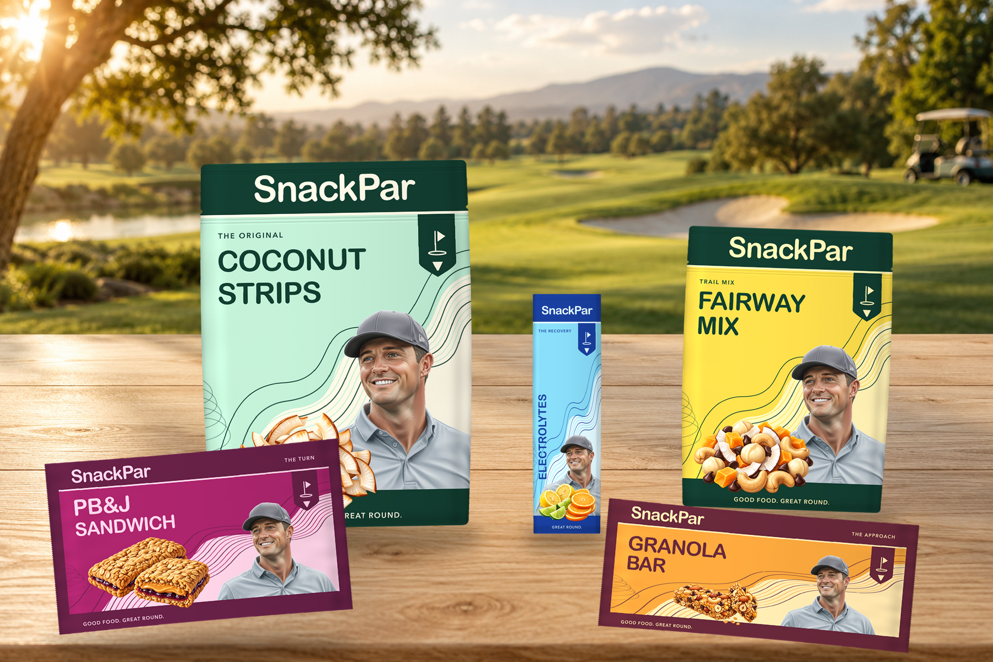
SnackPar
13
The first bag
starts here
The proposed next step
Coconut sample review and a scoped partnership discussion.
Outcome: agree product fit, rights to explore, responsibilities and a costed validation brief.
Notes:
The decision requested is to proceed to coconut sample review and a scoped discussion with the appropriate business team. This is not a request to approve a five-product launch, a claim that Bryson has endorsed SnackPar or an invented financing ask. A concrete next deliverable is a costed validation brief with product and pilot requirements, responsibilities, rights needed and decision gates. The on-course image is generated concept imagery, not documentary evidence of retail availability or a real endorsed product.

Slide 14
SnackPar
14
Evidence and open decisions
National Golf Foundation
2025 participation and change since 2019
Birdie Balls
Existing golf-focused protein balls and gifting
Par Bar Protein
Existing golf-positioned bar range
Known
The brand concept, product roadmap and proposed partnership model.
Still to establish
Taste, costs, shelf life, repeat demand, rights, partner fit and funding scope.
Primary sources checked October 3, 2026. No operating traction or commercial commitments have been supplied.
Notes:
Verified primary references, October 3, 2026: National Golf Foundation: https://www.ngf.org/short-game/golfs-growth-era-the-road-to-50-million-golfers/
Birdie Balls: https://www.birdieballs.golf/
Par Bar Protein: https://www.parbarprotein.com/
NGF article dated March 6, 2026. Competitor storefronts substantiate existence and positioning only. No competitor sales, efficacy or market share is claimed. Snack-scene evidence remains a secondary research lead, not a verified origin story. Working brief and source files supply concept scope. Generated product images are concept artwork. Missing actual operating evidence prevents characterizing this as a complete financing case.

